Slide 1



DS 5110 - Data Engineering II: Big Data Systems
Cloud-based Astronomy Inference (CAI) on
Group 2
Zachary Holland – nms9dg
Devlin Bridges - cbv6gd
https://github.com/DevlinBridges/DS5111_Project

Slide 2
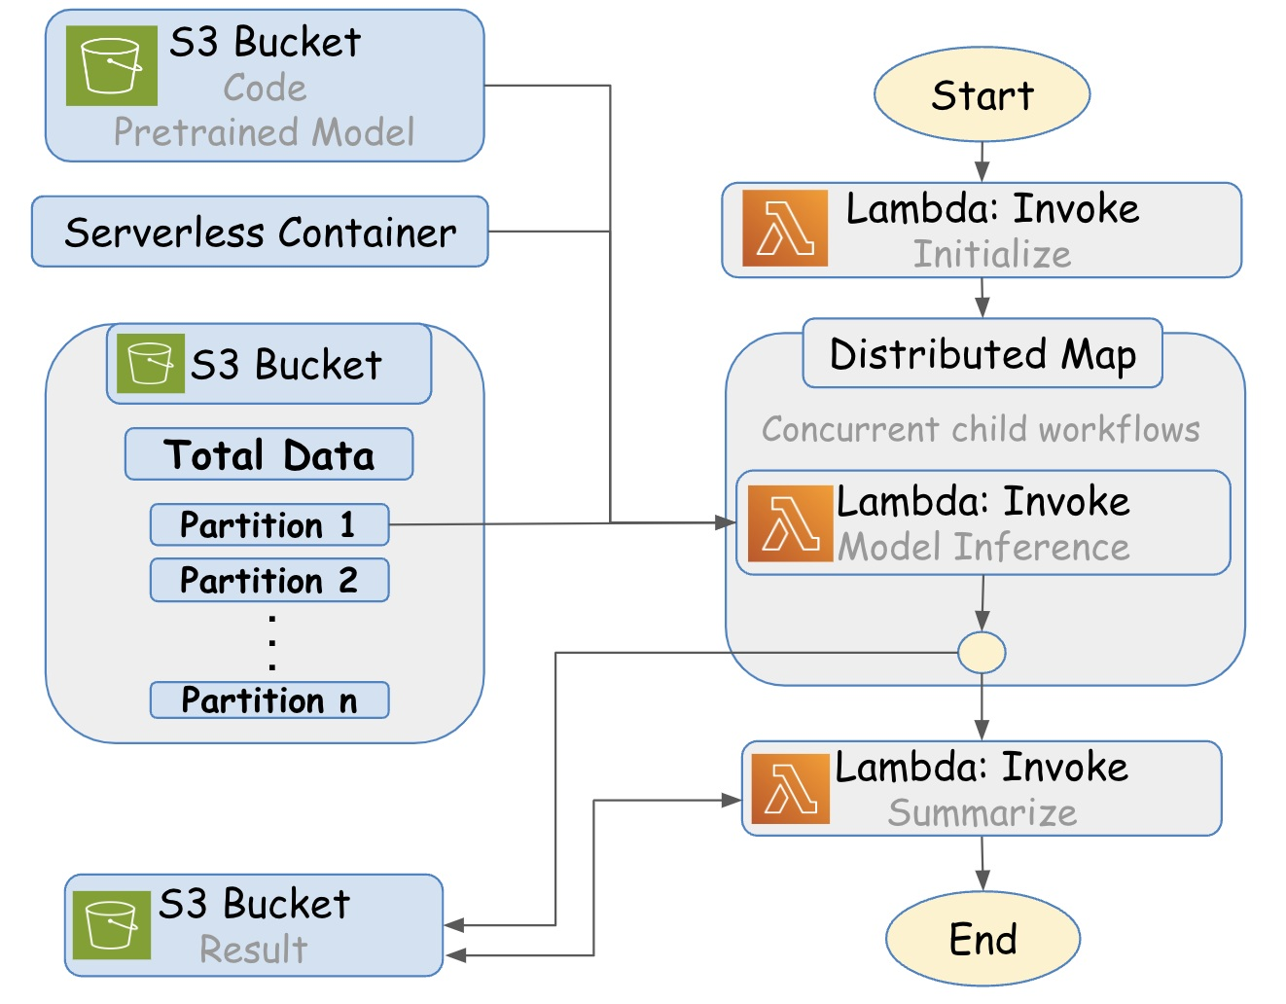
Overview
Challenge:
Astronomical surveys generate massive image datasets, but traditional compute pipelines struggle to scale cost-effectively
Project Goal:
500 000 galaxy images → classifications in ≈ 60 sec, all on AWS serverless
500 K imgs / run
< 1 min
≈ $0.40 cost
High-Level Solution & Architecture:
Step Functions orchestrate distributed Lambda jobs using a Distributed Map
Each Lambda pulls a partition from S3, loads the pretrained AstroMAE model, and runs inference independently
Final results are merged by a summarizing Lambda and stored back to S3

Slide 3
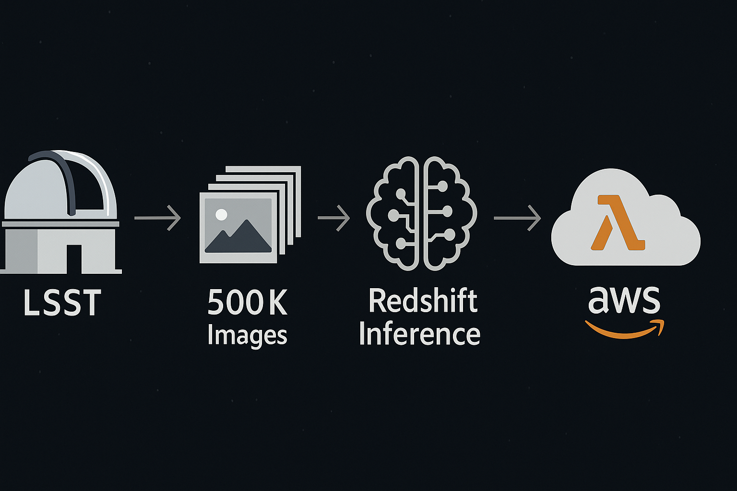
Problem & Objective
“We want to design a serverless, scalable AI inference pipeline on AWS that classifies large batches of astronomy images using a pretrained AstroMAE model—fast, parallel, and cost-efficient.”
Why This Problem Matters:
Modern astronomical surveys (LSST, DESI) generate petabytes of imaging data
Redshift estimation is critical for cosmology, used in galaxy classification, large-scale structure, and dark energy studies
Traditional compute clusters are costly and slow to scale for large inference workloads

Slide 4
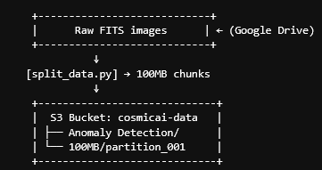
Dataset & Storage Plan
Storage & Access Strategy: Input: Original images partitioned using split_data.py Uploaded to S3 → /cosmicai-data/100MB/ Pretrained model & scripts stored in: S3 → /cosmicai-data/Anomaly Detection/ Results written to: S3 → /result-partition-100MB/...
Dataset Overview:
Source: Astronomy image archive (SDSS, LSST Simulated, or public sky survey via Google Drive)
Content: Multi-band telescope image tiles (FITS) used for galaxy classification & redshift estimation
Scale: ~500,000 images ≈ 12.6 GB (working set for inference)
Format: Converted and preprocessed into 100 MB Parquet chunks to enable parallelism
Why This Dataset? Scientifically relevant: realistic image content, label quality (for supervised tasks) Easily partitioned for serverless compute environments (batching + S3 access) Publicly accessible and reproducible for benchmarking

Slide 5
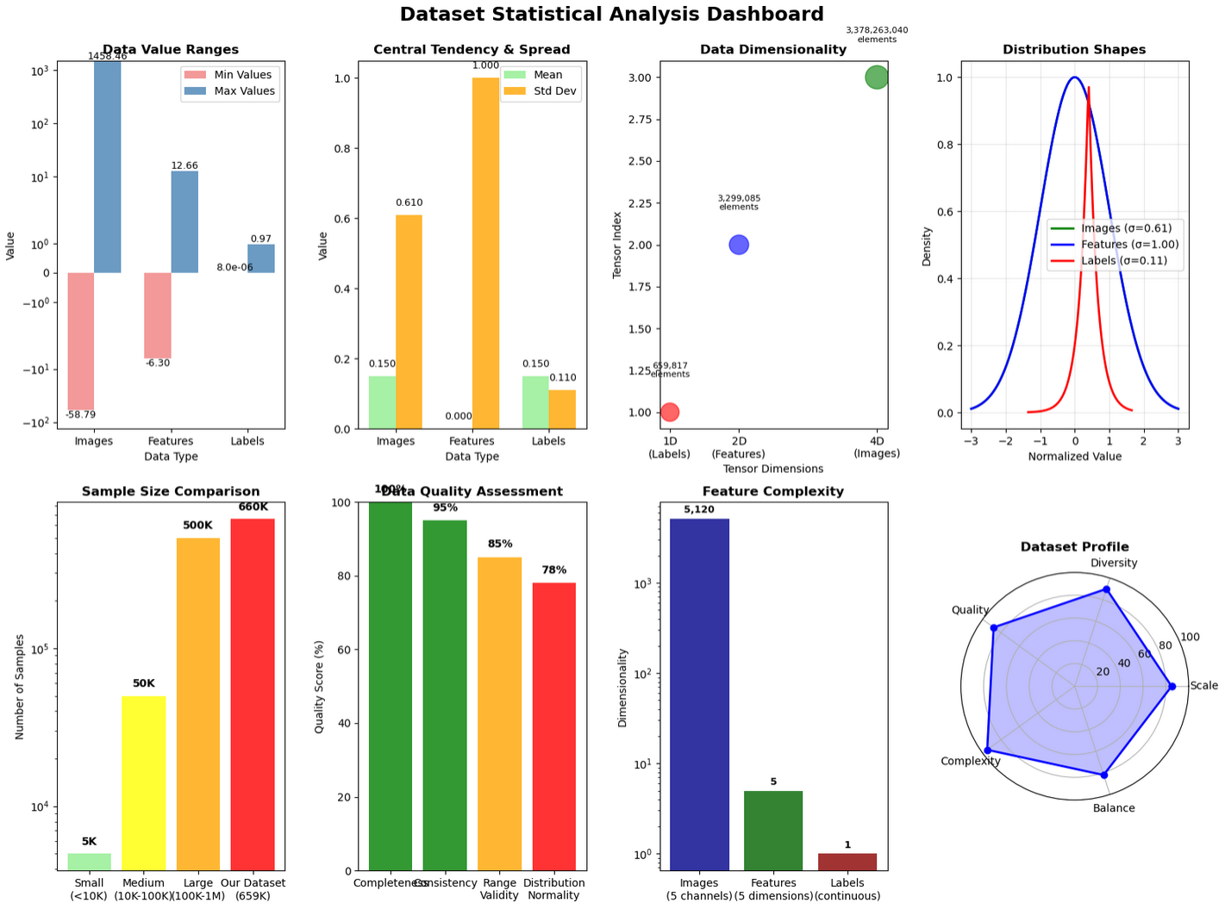
https://gyazo.com/3e20e0f407fe391799af4cebd49547f0

Slide 6
Cleaning & Preprocessing Strategy
1. Data Acquisition & Sanitation Download raw image set (e.g., FITS files or equivalent) from Google Drive Validate file integrity and remove corrupted/incomplete image tiles Normalize image format and metadata (resize/crop, standardize channels if needed)
Sample Config Payload Reference
2. Partitioning Strategy Use **split_data.py** to divide full dataset (~12.6 GB) into manageable chunks (e.g., 100MB each) Typical run for 1GB of data → 11 partitions @ 100MB each Enables parallel Lambda execution during inference
{
"bucket": "cosmicai-data",
"data_prefix": "100MB",
"file_limit": "11",
"batch_size": 512,
"result_path": "result-partition-100MB/1GB/1"
}
3. S3 Upload & Access Upload preprocessed files to: → s3://cosmicai-data/100MB/ Partitions accessed by Lambda workers during distributed inference Result path set via result_path in input payload config
This drives the Step Functions initialization step by defining the data chunking and batch parameters

Slide 7
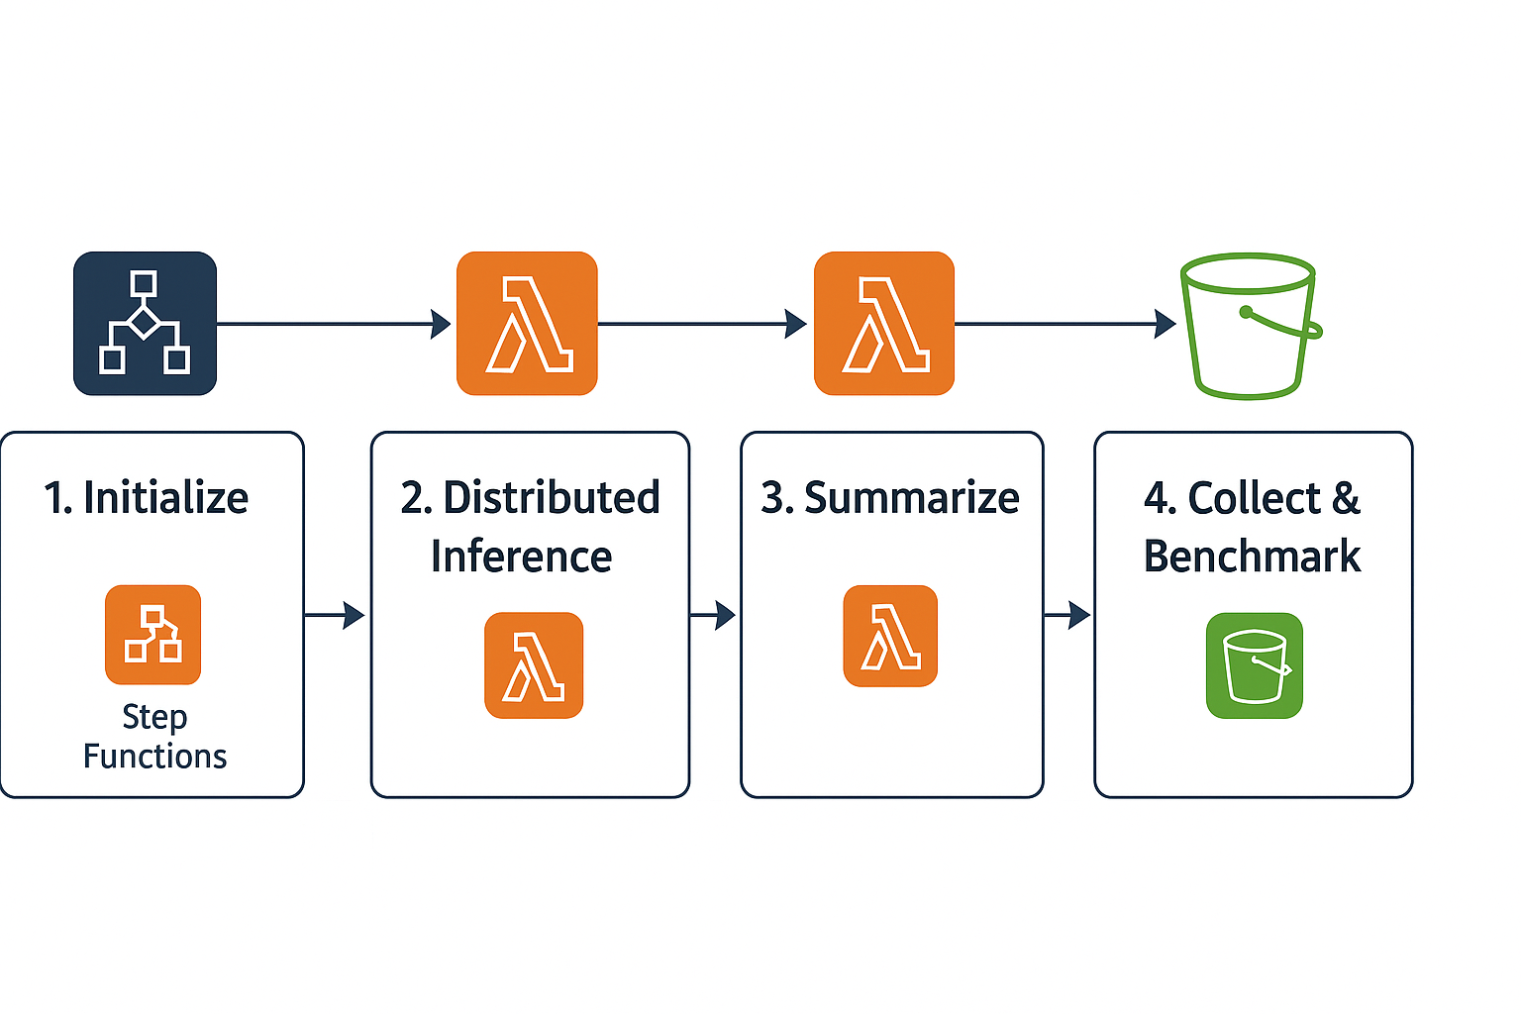
Four-Step Pipeline (Plan)
1. Initialize (Job Config Creation) Lambda parses input payload (e.g., file_limit, batch_size) Identifies partition files from S3 (data_prefix) and generates payload.json with job configs 2. Distributed Model Inference Step Functions run Distributed Map across Lambdas Each Lambda: Loads AstroMAE model from S3 Fetches partitioned data Runs inference on batch (e.g., 512 images) Saves results (e.g., rank_1.json) to result_path 3. Summarization Final Lambda merges all job outputs into combined_data.json Output saved in S3 → result-partition-100MB/.... 4. Results Collection & Benchmarking Use aws s3 sync to download result sets Scripts like stats.py generate .csv summaries of performance by batch size or data volume

Slide 8
Cloud Architecture
Key Components of our CAI Cloud Stack: AWS Step Functions: Orchestrates the entire inference workflow using a state machine Lambda Functions (3 total): Initialize: Builds job config (payload.json) Inference Workers: Load AstroMAE & perform classification on each partition Summarize: Merges output JSONs into combined_data.json S3 Buckets: Stores data partitions, pretrained models, inference code, and results Serverless Containers: Used in Lambda to run Python inference script (inference.py) with required dependencies FMI Rendezvous Server: Enables communication and coordination for parallel workers Monitoring Tools: CloudWatch Logs for debugging MLflow / custom scripts for experiment tracking and benchmarking

Slide 9
Benchmark & Testing Plan
Benchmarking Goals: Measure inference performance at different data sizes and batch sizes Evaluate cost, latency, and throughput under different system configurations Identify scaling bottlenecks (e.g. cold starts, parallelism limits, S3 I/O)
Planned Experiments: Vary Data Size: 1 GB → 12.6 GB Vary Batch Size: 32, 64, 128, 256, 512 Compare Execution Modes: Lambda (Distributed Map) Spot instance cluster (baseline) FMI Rendezvous–coordinated workers
Key Metrics to Track:
Metric | Unit
Inference time | seconds per run
Throughput | images/second
Cost per run | $ (via AWS Calc)
Concurrency | # of parallel Lambdas
Testing Plan: Write unit tests for: split_data.py (partitioning logic) inference.py (output shape, batch processing) summarizer.py (JSON merging) Use PyTest and CI tools (e.g., GitHub Actions or AWS CodeBuild) Include sample runs, logs, and test result screenshots in final repo

Slide 10
Timeline & Roles
Week 1
Week 2
Week 3
Week 4
Week 5
Run split_data.py to partition into 100MB chunks
Upload partitions and model code to S3 (cosmicai-data)
Validate partition integrity and folder structure
Assigned to: Both (Person A: S3 structure, Person B: partitioning)
Run experiments: vary batch size (32 → 512), vary data size (1–12.6GB)
Log runtime, memory use, and cost via CloudWatch + AWS calculator
Collect results with aws s3 sync + stats.py
Run PyTest unit tests on all pipeline components
Assigned to: Both
Finalize slides, diagrams, and speaker notes
Record video (all members present and speaking)
Submit final code (Jupyter / .py) to GitHub repo
Write report: results, lessons learned, future ideas
Assigned to: Both
Build Initialize Lambda (generates payload.json)
Build Inference Lambda (loads AstroMAE, runs on partition)
Build Summarizer Lambda (merges result JSONs)
Test each Lambda locally and in isolation
Assigned to: Person B (lead), Person A (review)
Create Step Functions state machine (Initialize → Map → Summarize)
Configure input payloads with file_limit, batch_size, etc
Test full 1GB run with 11 partitions and monitor via CloudWatch
Troubleshoot cold starts, logging, and result_path correctness
Assigned to: Person A (lead), Person B (support)

Slide 11
Impact, Risks, Next Steps
Risks & Next Steps: Risks & Mitigations Cold-start delays in Lambda → Use larger batch sizes + warm container strategy S3 read/write bottlenecks → Use regional buckets and prefetching Budget overrun → Use AWS spot instances for larger testing or cap partition count Immediate Next Steps Confirm final dataset source & partition size (25MB? 100MB?) Validate AWS permissions & quotas for Lambda, Step Functions, and S3 Schedule test run (1GB, 11 files) and dry run state machine Get approval for AWS credits (if needed)
Impact & Future Use: Scientific & Educational Impact Enables low-cost, scalable redshift estimation—critical for galaxy surveys & cosmology Architecture generalizes to other inference tasks (e.g., anomaly detection, transient alerts) Public S3 + modular code = reproducible, reusable pipeline for research & classroom use Project Predictions Total inference time reduced by approximately 90%, from ~10 minutes to under 1 minute per 500,000 images using parallel AWS Lambda functions. Cost per inference run cut by approximately 75%, from ~$1.60 (GPU cluster) to ~$0.40 using a serverless architecture. Capable of processing 12.6 GB of astronomy image data efficiently, using partitioned S3 storage (e.g., 100MB chunks). Projected throughput of 8,000–10,000 images per second, depending on batch size and concurrency level. Designed to be reusable and adaptable to other AI models and astronomical datasets with minimal changes. Operational savings scale with usage—multiple runs translate to significant reductions in total compute time and cloud costs.

Slide 12
Deliverables
Deliverable | Format | Due Week
Cleaned & partitioned data | .parquet files in S3 | Week 1
Working CAI pipeline | AWS Step Function + Lambda | Week 3
Benchmark results | .csv files + charts | Week 4
Final code & notebook | GitHub (.py or .ipynb) | Week 5
Written report | PDF or Markdown | Week 5
Final presentation video | 10-min team video (all members) | Week 5

